Slide 1
Recurrent Neural Network

Slide 2
Motivation
Not all problems can be converted into one with fixed length inputs and outputs
Problems such as Speech Recognition or Time-series, prediction require a system to store and use context information
– Simple case: Output YES if the number of 1s is even, else NO 1000010101 – YES, 100011 – NO, …
Hard/Impossible to choose a fixed context window
– There can always be a new sample longer than anything seen

Slide 3
Recurrent Neural Network
Recurrent Neural Networks take the previous output or hidden states as inputs.
The composite input at time t has some historical information about the happenings at time T < t.
RNNs are useful as their intermediate values (state) can store information about past inputs for a time that is not fixed a priori.

Slide 4
RNN
Good for Sequential data, or ordered data
Internal memory: remember important things about input
Produces output, copies the output, loop it back into input
Input, forget, output gate

Slide 5
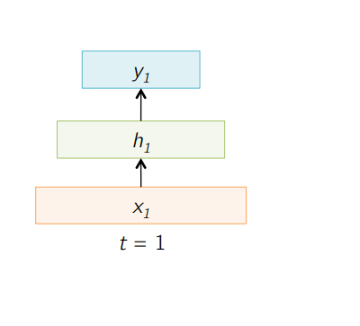
Sample Feed forward Network

Slide 6
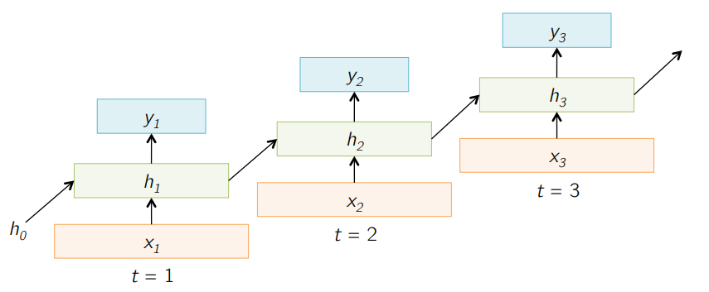
Sample RNN

Slide 7
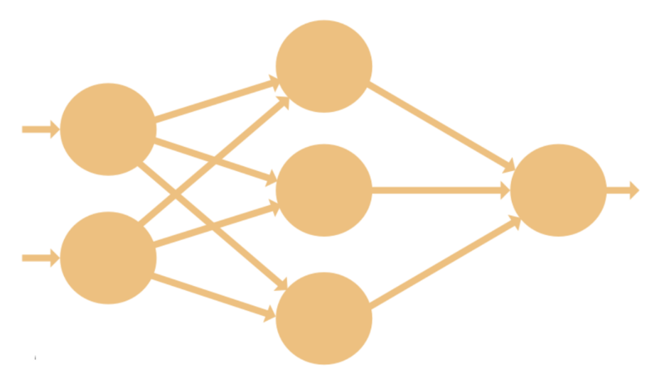
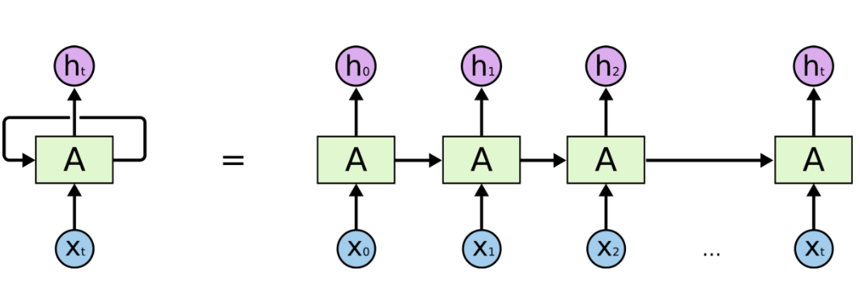
Difference between RNN and CNN

Slide 8
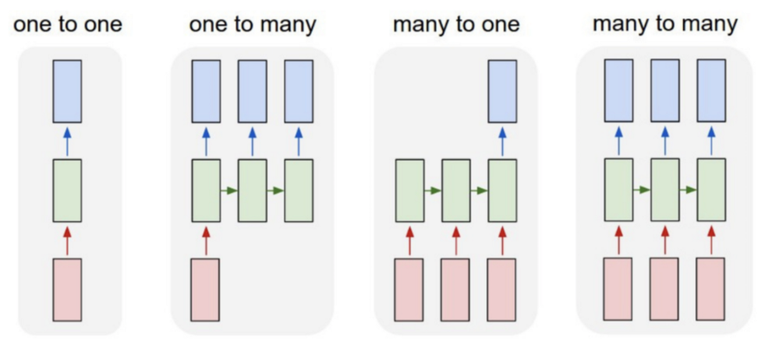
Different kind of RNN
One to many: image to many words
many to many (translation)
many to one (classifying a voice)

Slide 9

Formula of RNN
The hidden state at time step t is h_t

Slide 10
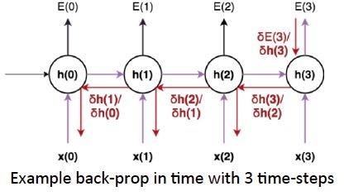
Recurrent Neural Network
Back Propagation Through Time (BPTT): The training method has to take into account the time operations → a cost function E is defined to train our RNN, and in this case the total error at the output of the network is the sum of the errors at each time-step:

Slide 11


Limitations of RNNs
Recurrent Neural Networks work just fine when we are dealing with short-term dependencies. That is when applied to problems like:
RNNs turn out to be quite effective. This is because this problem has nothing to do with the context of the statement. The RNN need not remember what was said before this, or what was its meaning, all they need to know is that in most cases the sky is blue. Thus the prediction would be:

Slide 12
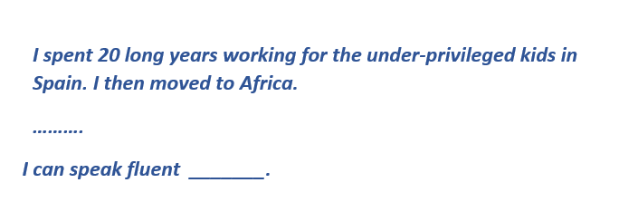
Limitations of RNNs
However, simple RNNs fail to understand the context behind an input. Something that was said long before, cannot be recalled when making predictions in the present. Let’s understand this as an example:
we can understand that since the author has worked in Spain for 20 years, it is very likely that he may possess a good command over Spanish. But, to make a proper prediction, the RNN needs to remember this context. The relevant information may be separated from the point where it is needed, by a huge load of irrelevant data. This is where a Recurrent Neural Network fails!

Slide 13
Limitations of RNNs
The reason behind this is the problem of Vanishing Gradient.
We know that for a conventional feed-forward neural network, the weight updating that is applied on a particular layer is a multiple of the learning rate, the error term from the previous layer and the input to that layer.
Thus, the error term for a particular layer is somewhere a product of all previous layers’ errors.
When dealing with activation functions like the sigmoid function, the small values of its derivatives (occurring in the error function) gets multiplied multiple times as we move towards the starting layers. As a result of this, the gradient almost vanishes as we move towards the starting layers, and it becomes difficult to train these layers

Slide 14
Problems with sigmoid function
one of the most widely used activation functions today. Then what are the problems with this?
Towards either end of the sigmoid function, the Y values tend to respond very less to changes in X
What does that mean?
The gradient at that region is going to be small
Problem of “vanishing gradients”

Slide 15
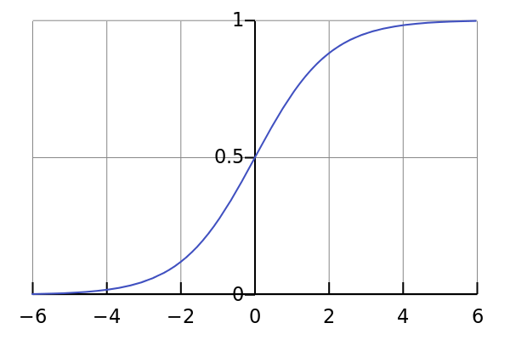
Limitations of RNNs
Sigmoid Function
3

Slide 16
Recurrent Neural Network
Main problems:
Exploding Gradients: weights assigns high importance
Vanishing Gradients: values of gradients are too small.
model stops learning

Slide 17
Improvement over RNN: LSTM (Long Short-Term Memory) Networks

Slide 18
LSTM
LSTMs on the other hand, make small modifications to the information by multiplications and additions.
With LSTMs, the information flows through a mechanism known as cell states. This way, LSTMs can selectively remember or forget things. The information at a particular cell state has three different dependencies.
The previous cell state (i.e. the information that was present in the memory after the previous time step)
The previous hidden state (i.e. this is the same as the output of the previous cell)
The input at the current time step (i.e. the new information that is being fed in at that moment)

Slide 19

Long Short Term Memory (LSTM) cell
An LSTM cell is defined by two groups of neurons plus the cell state (memory unit):
Gates
Activation units
Cell state
Computation Flow

Slide 20
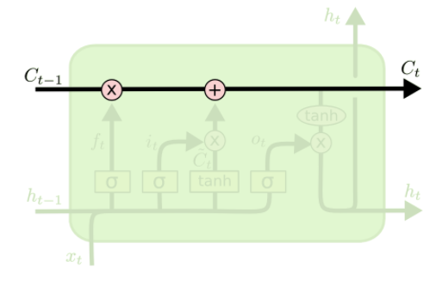
Core idea behind LSTM
key to LSTMs is the cell state
horizontal line running through the top of the diagram
have the ability to remove or add information to the cell state regulated by structures called gates

Slide 21
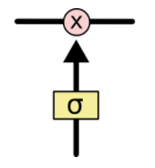
Gate
a sigmoid neural net layer and a pointwise multiplication operation
sigmoid layer outputs numbers between zero and one, describing how much of each component should be let through
An LSTM has three of these gates, to protect and control the cell state.

Slide 22
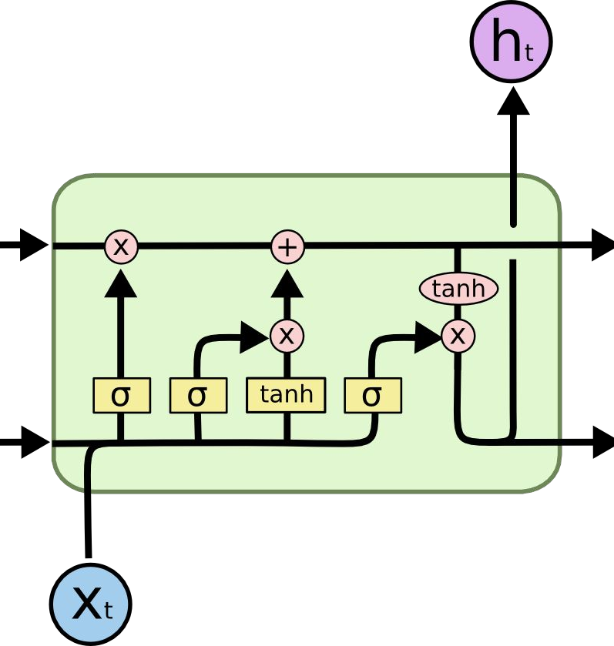
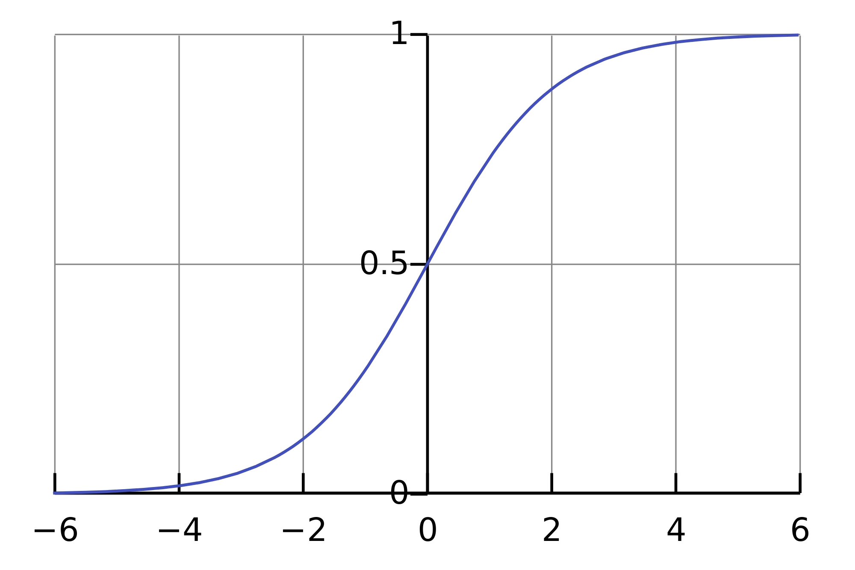
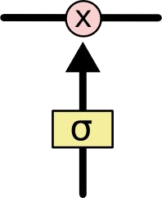
Long Short-Term Memory (LSTM)
Three gates are governed by sigmoid units (btw [0,1]) define the control of in & out information..

Slide 23
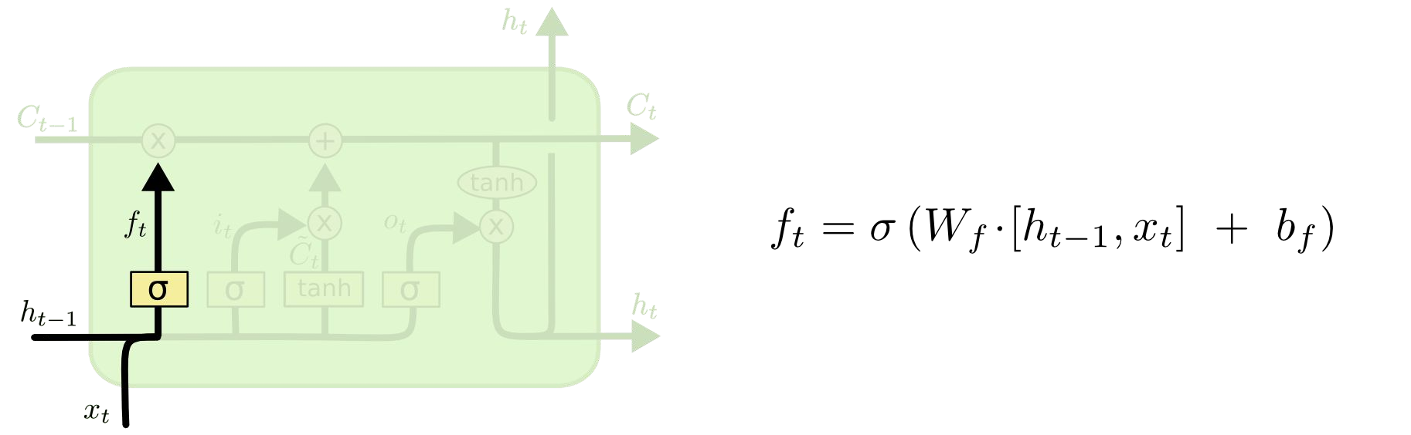
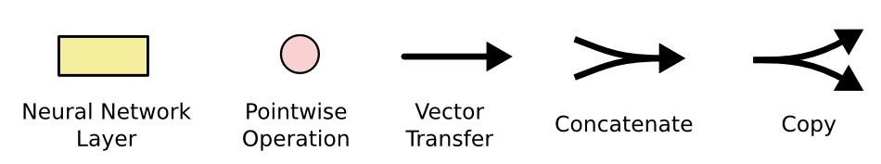
Long Short-Term Memory (LSTM)
Forget Gate
Concatenate

Slide 24
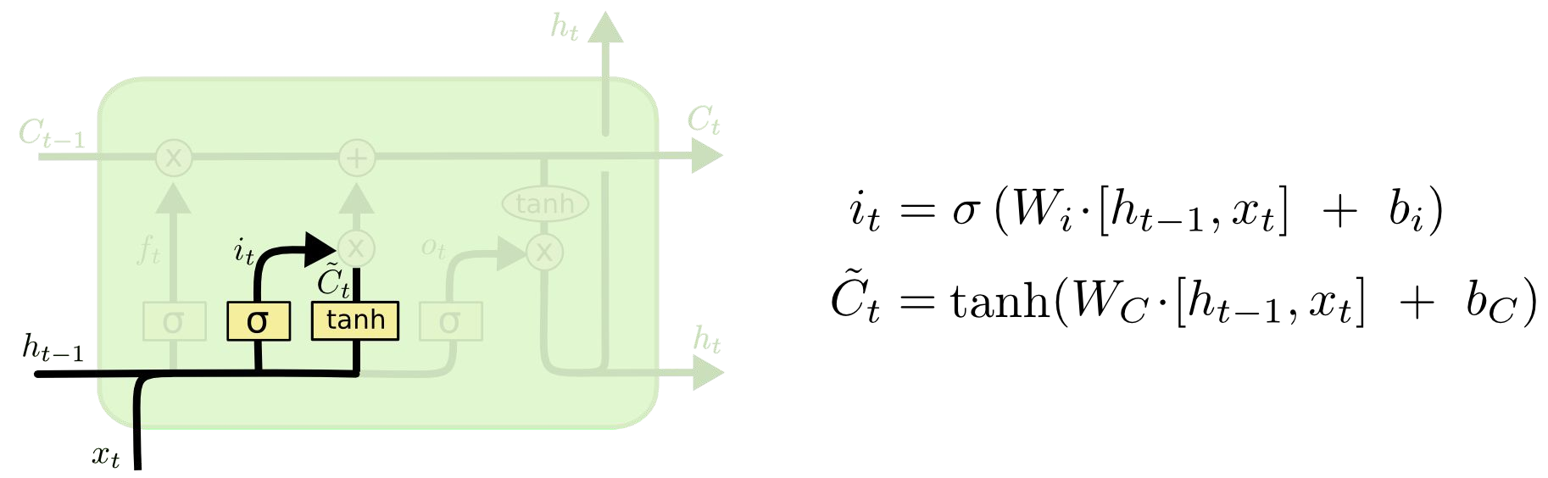
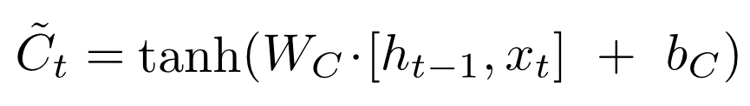
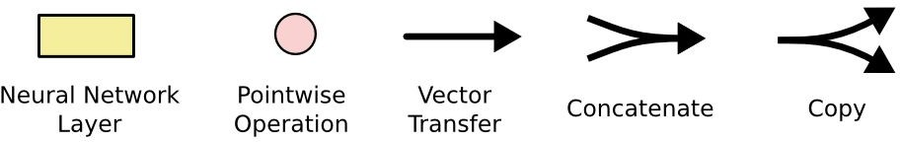
Long Short-Term Memory (LSTM)
Input Gate Layer
New contribution to cell state
Concatenate

Slide 25
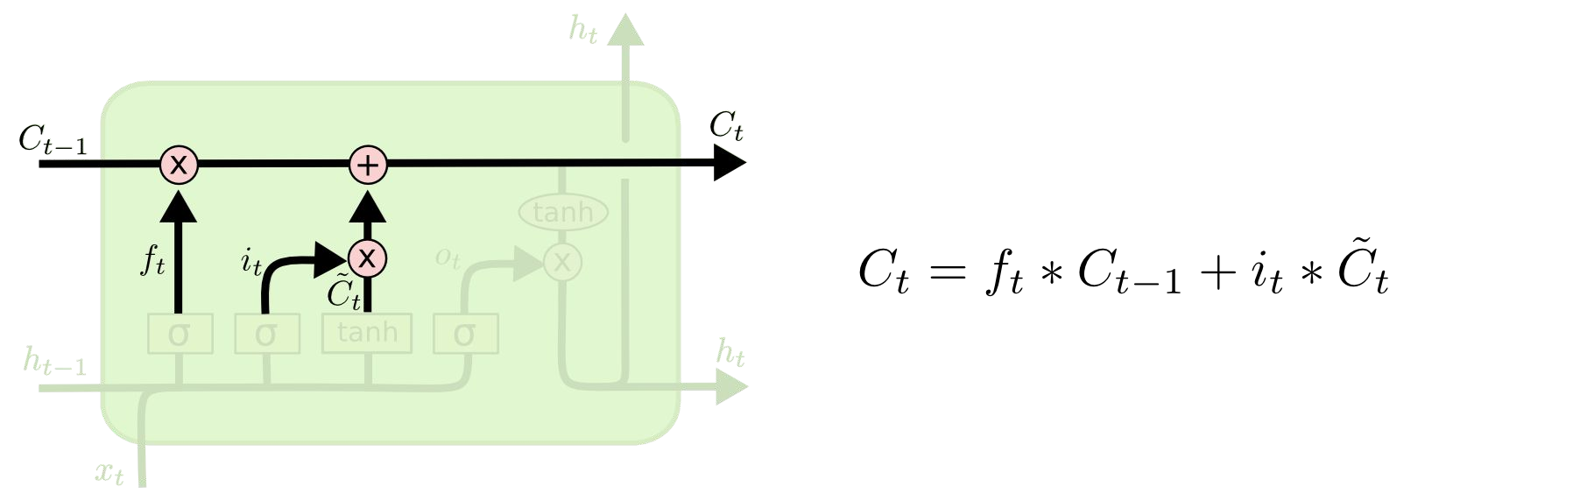
Long Short-Term Memory (LSTM)
Update Cell State (memory)

Slide 26
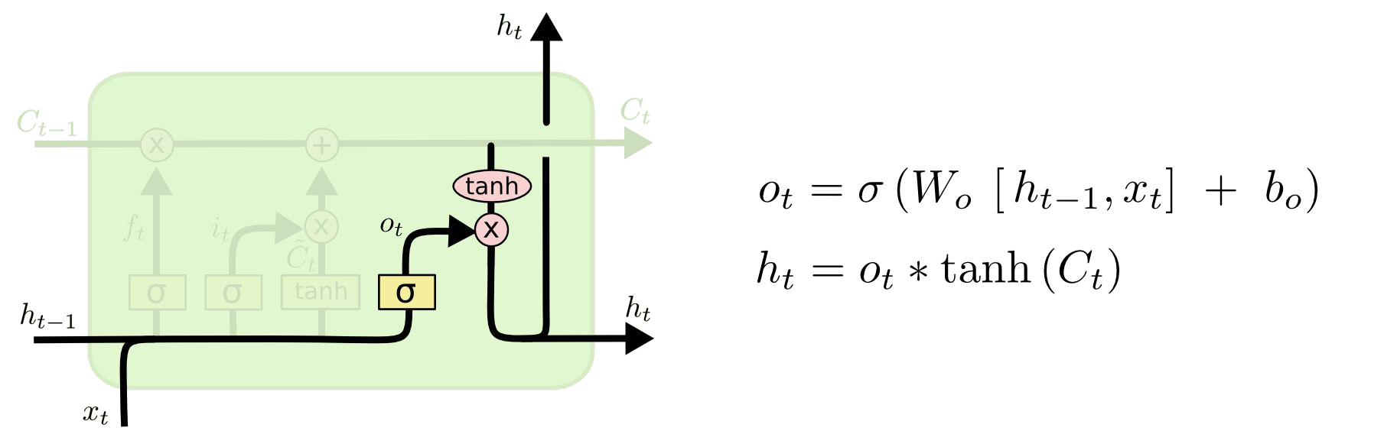
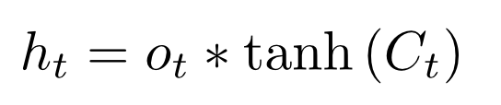
Long Short-Term Memory (LSTM)
Output Gate Layer
Output to next layer

Slide 27

Long Short-Term Memory (LSTM)

Slide 28
Use case: Text Generator
Suppose we want to train a LSTM to predict the next word using a sample short story
feed a LSTM with correct sequences from the text of 3 symbols as inputs
eventually the neural network will learn to predict the next symbol correctly

Slide 29
refrences
https://towardsdatascience.com/lstm-by-example-using-tensorflow-feb0c1968537
https://medium.com/@erikhallstrm/hello-world-rnn-83cd7105b767
https://towardsdatascience.com/exploring-activation-functions-for-neural-networks-73498da59b02
https://medium.com/lingvo-masino/introduction-to-recurrent-neural-network-d77a3fe2c56c
http://colah.github.io/posts/2015-08-Understanding-LSTMs/
https://www.slideshare.net/ashraybhandare/deep-learning-cnn-and-rnn?qid=0f39b4da-a290-4e9e-9d31-ed21816598e3&v=&b=&from_search=27

Slide 30
Thank You!

